Slide 1

WannaCry 2017
Global Ransomware Attack

Slide 2
Our Team
WannaCry 2017
Jeba Tahsin Annika
Sudipta Das
Rizoan Ahmmed Rasel
Nafisa Ferdous Subah
MD. Aminul Islam

Slide 3
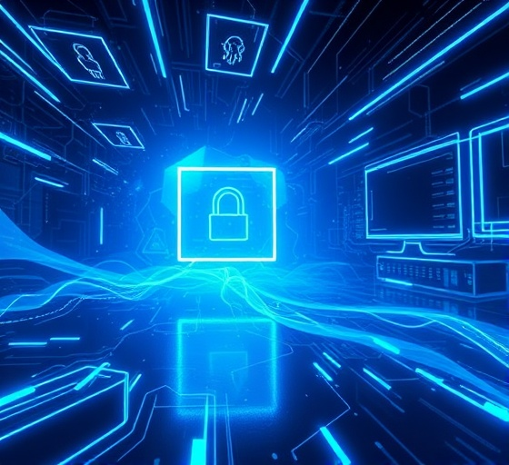
What is WannaCry?
WannaCry 2017
Overview
Ransomware cryptoworm (May 2017). Exploited Windows SMBv1 (EternalBlue). Demanded Bitcoin payments. Major global cybersecurity incident (IEEE).

Slide 4

How It Works
WannaCry 2017
Overview
SMBv1 vulnerability (CVE-2017-0144)
Worm-like self propagation
Encrypts files (AES-128)
Displays ransom note

Slide 5

Propagation & Vulnerability
WannaCry 2017
Propagation & Vulnerability
EternalBlue exploit from NSA leak
Affected unpatched Windows systems
Legacy systems at high risk

Slide 6
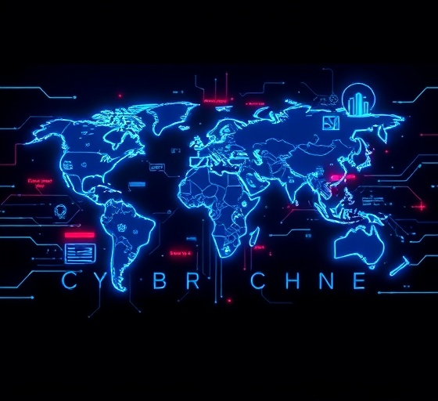
Major Affected Organizations
WannaCry 2017
Affected Organizations
UK NHS: Healthcare disruption
FedEx: ~$400M loss
Renault & Nissan: Production halted
Telefónica, Honda, Hitachi

Slide 7

Research Insights
WannaCry 2017
Security Measures
MS17-010 patch could prevent attack
Risks to critical infrastructure
Network segmentation limits spread

Slide 8
IEEE Rule & Ethical Breaches
Wannacry 2017
IEEE Code of Ethics Violations
Clause 1: Endangered public safety by operating unpatched systems
Clause 3: Failed to improve technical competence and security practice
Clause 5: Neglected risk analysis and vulnerability disclosure
Clause 7: Ignored responsibility to maintain reliable and secure systems
Clause 9: Allowed preventable harm due to poor cybersecurity governance

Slide 9

Ransomware Economics
WannaCry 2017
Ransomware Impact
$300–$600 Bitcoin ransom
Global losses $4–$8 billion
Few attackers collected funds

Slide 10

Prevention Strategies
WannaCry 2017
Regular Updates
Strong Backups
Responsible Action
Protect Public Safety
User awareness training

Slide 11
Lessons Learned
WannaCry 2017
Affected Organizations
Legacy systems are dangerous
Cyber hygiene is critical
Incident response planning needed

Slide 12
Conclusion
WannaCry 2017
Questions?
Spread across 150+ countries within hours.
Exploited outdated and unpatched Windows systems.
Critical sectors such as Hospitals, Banks, Telecom & transport systems were heavily impacted.

Slide 13
Conclusion
WannaCry 2017
Questions?
A global wake-up call.
Highlighted need for stronger cybersecurity.
Overreliance on legacy systems increased vulnerability.
Cybersecurity is essential, not optional.

Slide 14

Looking For Questions? ☺
WannaCry 2017

